Slide 1
Machine Learning Based Real-Time Geosteering
Ngoc Tran
May 06th 2018
Data Analytics Final Project

Slide 2

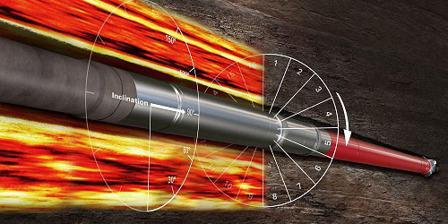
Introduction & Problems
Can we use Drilling measurements to interpret rock properties ?
14000 horizontal well drilled in 2018 targeted shale plays
However, a few shale plays have multiple target zone.
Real-time geosteering applications: remain in-zone or steer towards a target
Knowledge of petrophysical/ rock mechanical properties surrounding drilling bit
LWD -> information with considerable addition costs
Machine Learning Techniques to predict lithology by using MWD data

Slide 3

Data Acquisition
Dataset released by Equinor and taken from Volve field in Norwegian Continental Shelf
12 wells (open hole and MWD logs) and 3 cored wells
Open Hole logs: neutron, density, GR, sonic and PE logs
MWD: surface RPM, WOB, Torque, ROP, Downhole Pressure and Temperature, Mud Pump Flow Rate, ECD, etc.

Slide 4
Workflow
Log Data – Sonic (DT), Gamma Ray (GR), Density (RHOB), MWD
Basic statistic analysis: Boxplots and Linear Regression
Identify Lithology Clusters on DT, GR and RHOB
15 wells
K-means and Self-Organizing Map (SOM)
Petrophysical Significance of Lithology clusters
Identify cluster properties using core data (3 wells)
Predict Lithology clusters using MWD data
Outlier removal (Z-score), Scaling and Centering on 12 wells
KNN, Support Vector Machine and Random Forest

Slide 5
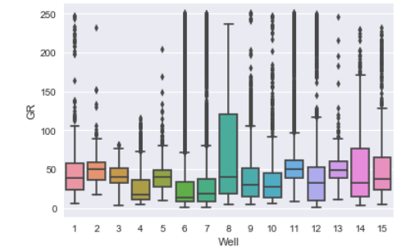
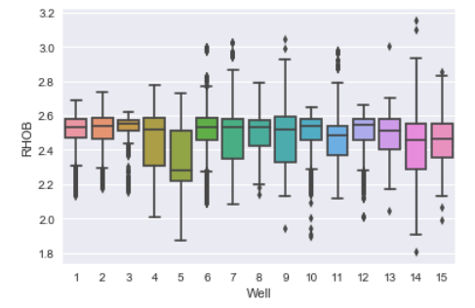
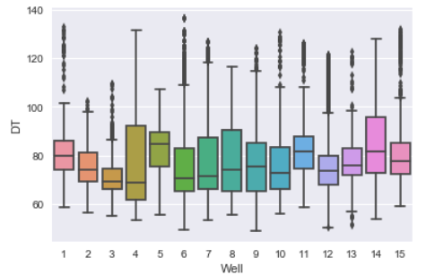
Basic Statistics Analysis - Lithology
Box plots for log variables in 15 wells:
GR
Compressional P-wave slowness (DT)
Bulk Density (RHOB)
Similar distribution
Notes:
Box plots and probability density function (PDF) plots are often best used tools for univariate analysis. Figure 6 shows the box plots for the log variables namely gamma ray (GR), compressional p-wave slowness (DT) and bulk density (RHOB). The figure shows very similar distribution for different wells.

Slide 6
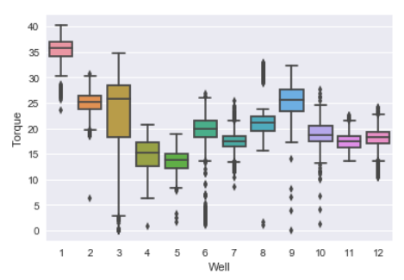
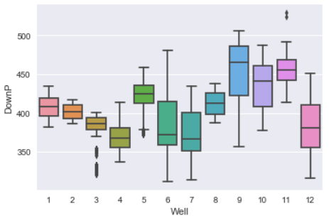
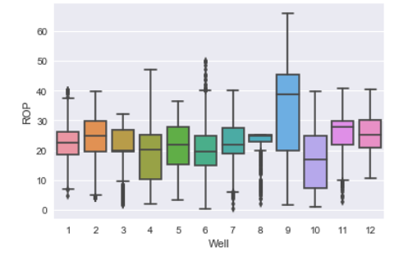
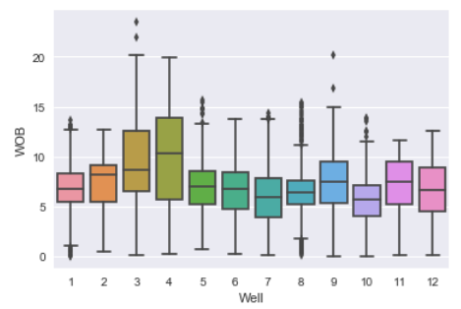
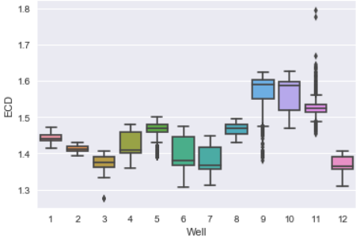
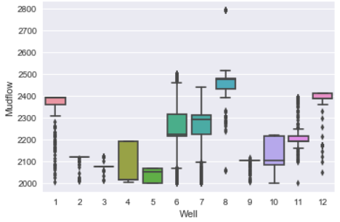
Basic Statistics Analysis – MWD data
ROP and WOB shows similar distribution
Torque, Pressure, ECD reveals different distribution -> Different depths of zone of interest -> Depth-dependent variables

Slide 7
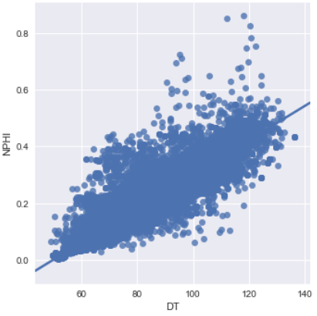
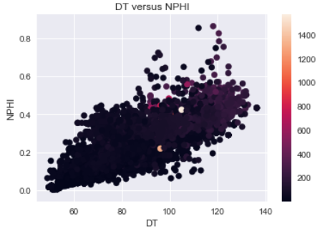
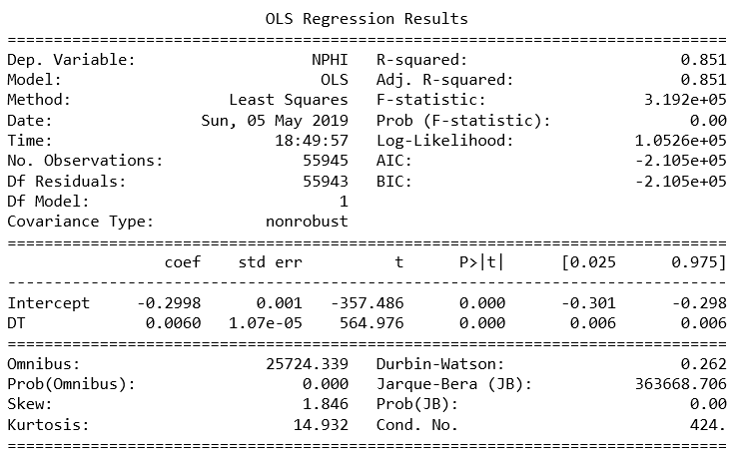
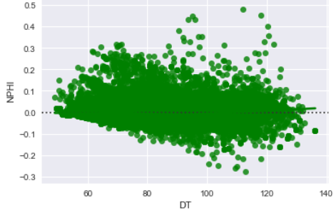

Linear Regression: DT vs. NPHI
Linear regression plots
Residual plot
Notes:
DT and NPHI good correl, positive correlation. We don’t need to take both logs for cluster and choose 1. NPHI strong impacted by fluid content -> DT is better. B/c wanna choose log sensitive to lithology

Slide 8
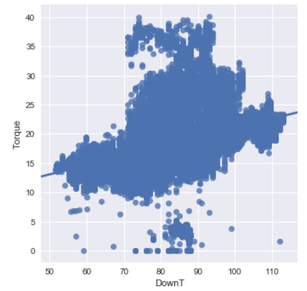
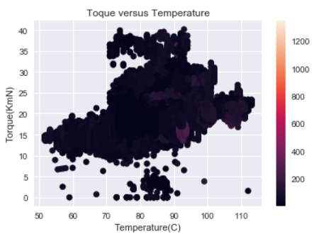
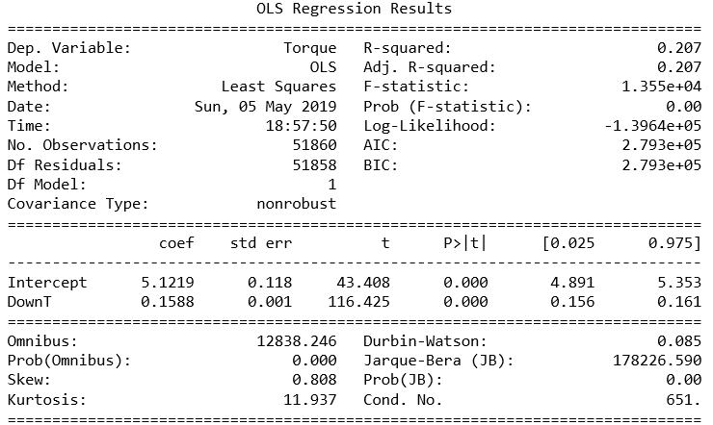
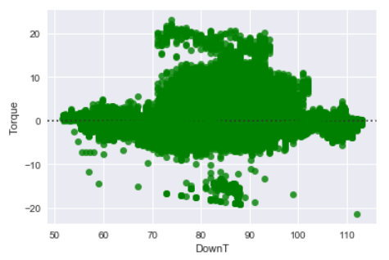
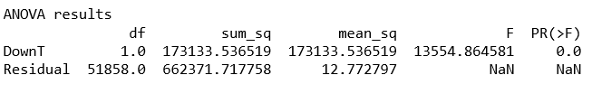
Linear Regression on Torque vs. Temperature
Linear regression plots
Residual plot
Notes:
R-square btw Torque and temperature shows the correlation low. R2 even lower among other drilling parameters. Implies different parameters are not correlated to each other.
Residual plot show heteroscedascticity

Slide 9
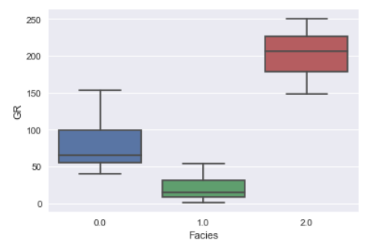
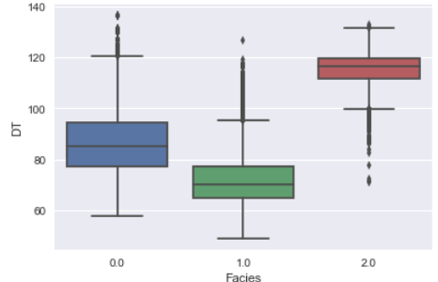
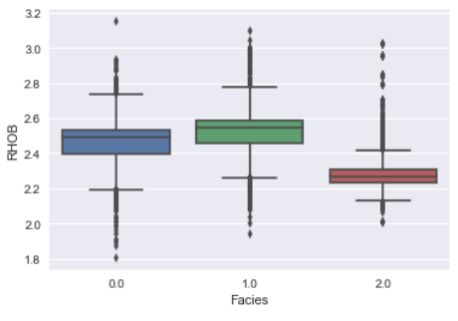
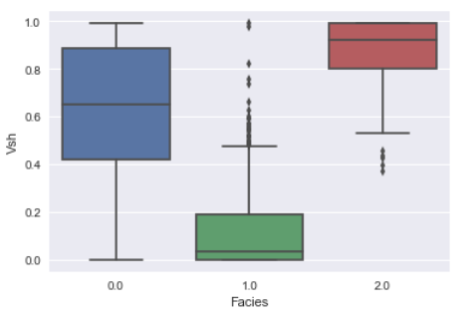
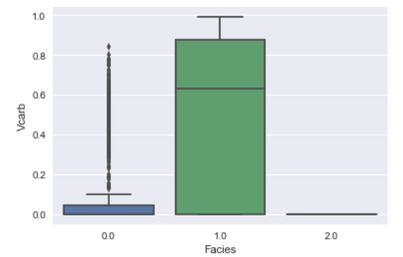
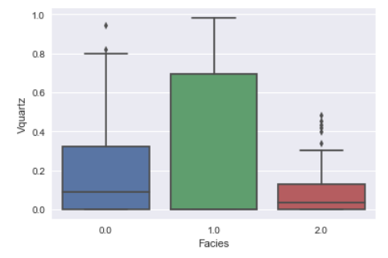
K-Means Clustering on Log Data
Notes:
Facies 2: shale
Facies 1: calcareous sandstone
Facies 0: shaly sandstone

Slide 10
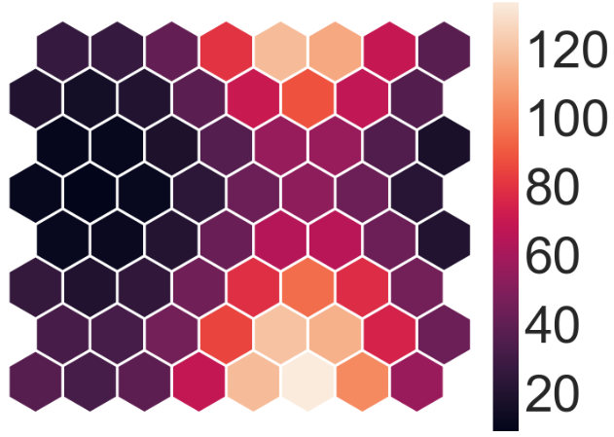
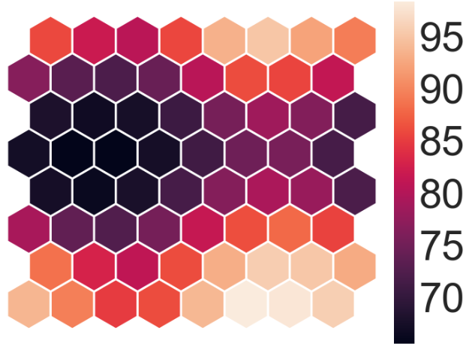
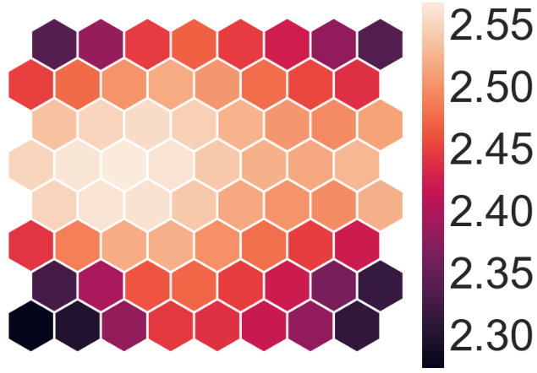
Self Organizing Map (SOM) for 3 clusters
Node Grid with GR
Node Grid with DT
Node Grid with RHOB
Facies 1
Facies 0
Facies 1
Facies 0
Facies 1
Facies 0
Facies 2
Facies 2
Facies 2
Notes:
Facies 2: GR high, DT high, RHOB low
Facies 1: GR low, DT low, RHOB high
Facies 0: GR intermediate (higher facies 1), DT relatively intermediate and RHOB high

Slide 11
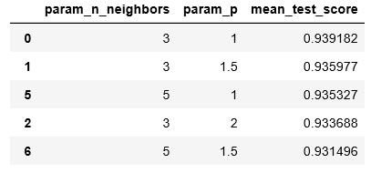

KNeighbors Classification
This technique predicts facies cluster based on MWD
Features: MWD Data
Target: Facies
Number of Samples: 51877 & Number of features: 6
Using train_test_split package given by Python
Train set: 80% Dataset & Test set: 20 % Dataset
Hyperparameter Optimization by using GridSearch and Cross Validation KFold

Slide 12
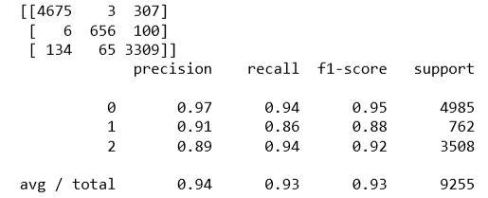

Support Vector Machine (SVM) classification
This technique predicts facies cluster based on MWD
Features: MWD Data
Target: Facies
Using train_test_split package given by Python
Train set: 80% Dataset & Test set: 20 % Dataset
Dataset removed outlier (Z-score) and scaled
SVM Model Parameter: C= 10, kernel= Radial Basis Function (rbf)
Confusion Matrix
Scores

Slide 13
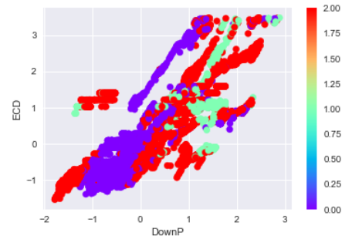
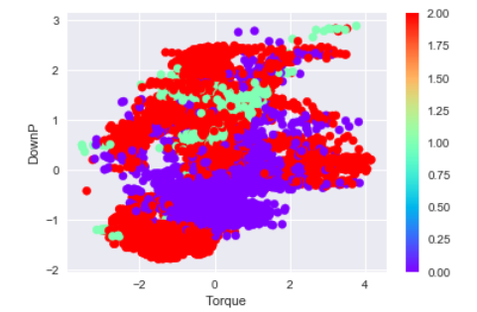
Support Vector Machine (SVM) classification
Facies
Facies
Notes:
SVM
Slide shows crossplots among drilling parameters and how measurements for different facies shown up in crossplot.
The three facies 1 has high downP and high ECD
Facies0: low down P and ECD
Facies2: all around
Cross plot DownP and Torque
Facies 1: middle, facies 0: lower and facies 2: distribute throughout

Slide 14
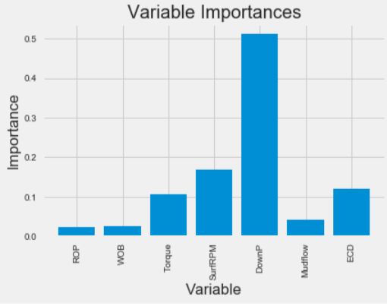
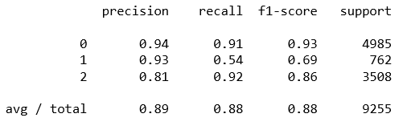
Random Forest
Using train_test_split package given by Python
Train set: 80% Dataset & Test set: 20 % Dataset
Dataset outlier removed (Z-score) and scaled
This method also allows to evaluate the variable importance
Initial tuning parameter: n_estimators= 200, max_depth =5, max_features=4
As for initial tuning parameter
Memorization performance: 0.882
Generalization performance: 0.884
Notes:
Downhole pressure most important parameter

Slide 15
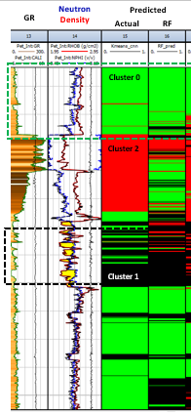
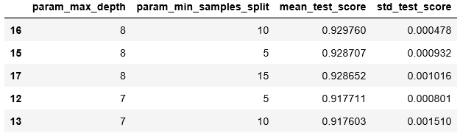
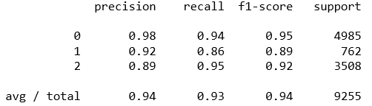
Random Forest Hyperparameter Optimization and Validation on Log
Hyperparameter optimization with GridSearch and KFold cross validation

Slide 16

Conclusions
The unsupervised and supervised techniques shows the great promise
Unsupervised methods allow the predictions of 3 facies
Supervised methods
KNN gives 94% accuracy in cluster prediction on test dataset
SVM gives 94% accuracy in cluster prediction on test dataset
Random Forest gives 93% accuracy in cluster prediction on test dataset
Application to drilling automation and advisory systems
Prevent out-of-zone drilling
Minimizes rig-time and equipment
Cost saving

Slide 17
References
The dataset for the current study has been taken from the Volve field on the Norwegian Continental Shelf (NCS) released by Equinor ASA. Weblink: https://data.equinor.com/authenticate. [70,000 samples. 21 features]

